Slide 1
PROMPT PATTERNS

Slide 2
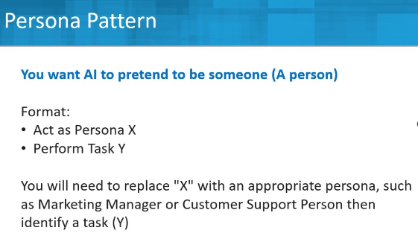
Act as a Marketing Manager and develop a complete marketing plan to market our new organic toothpaste.

Slide 3
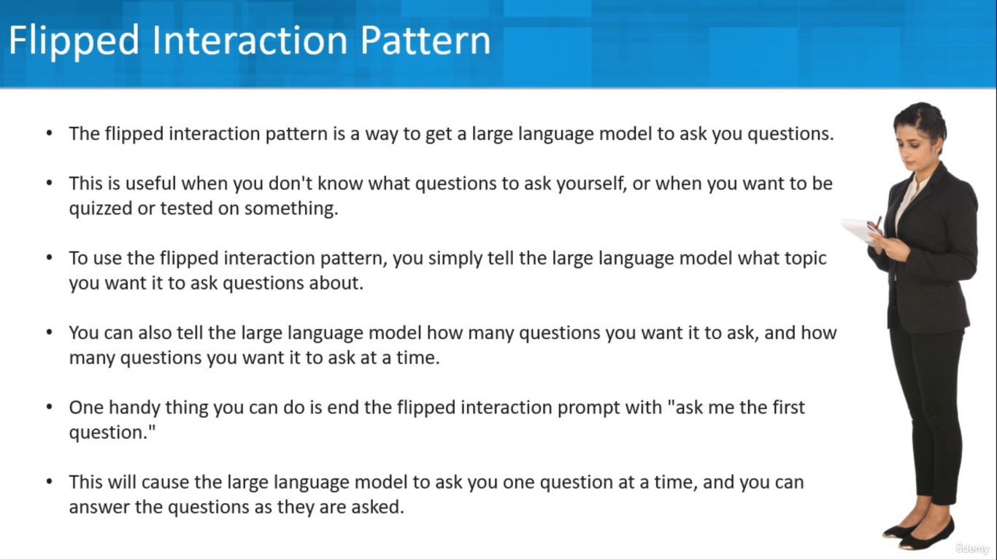

Slide 4
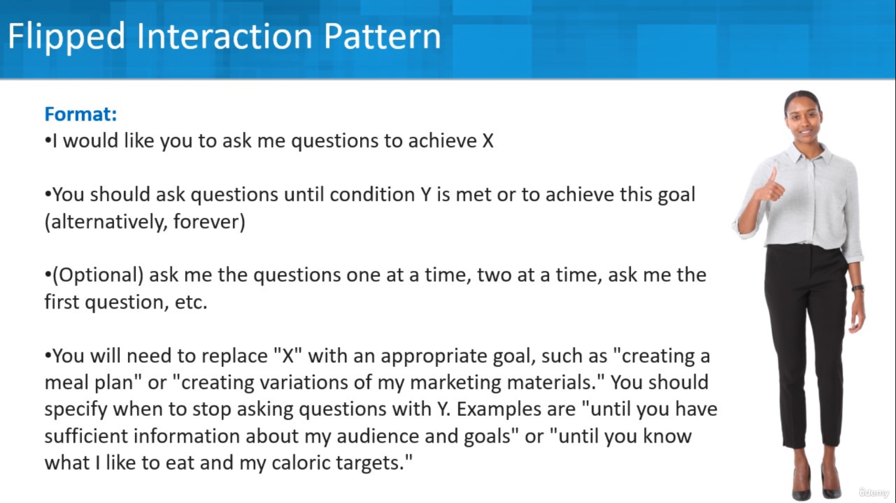

Slide 5
Example
I would like you to ask me questions to help me prepare for my upcoming interview. I am interviewing for an entry level accounting job. Pretend you are a manager, a skilled interviewer, and will be my possible future boss. Ask me one question at a time and wait for my response. Let's start with you asking the first question.

Slide 6
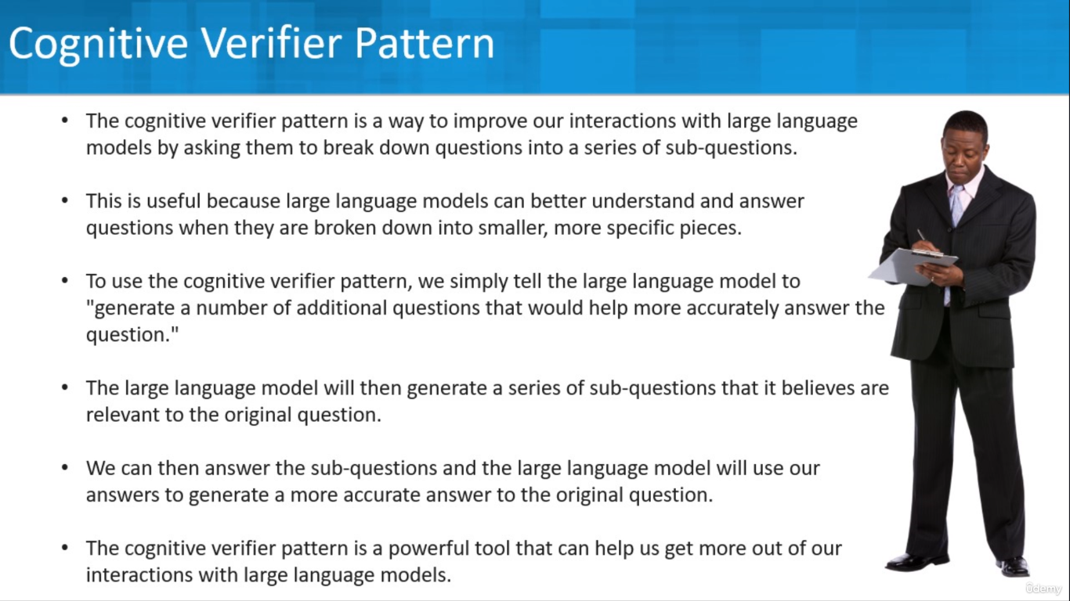

Slide 7
Example
When you are asked a question, follow these rules.
Generate additional questions that would help you more accurately answer the question. Combine the answers to the individual questions to produce the final answer to the overall question.
I want to focus on only one type of social media advertising to promote my Online course Company. Which one should I choose?

Slide 8
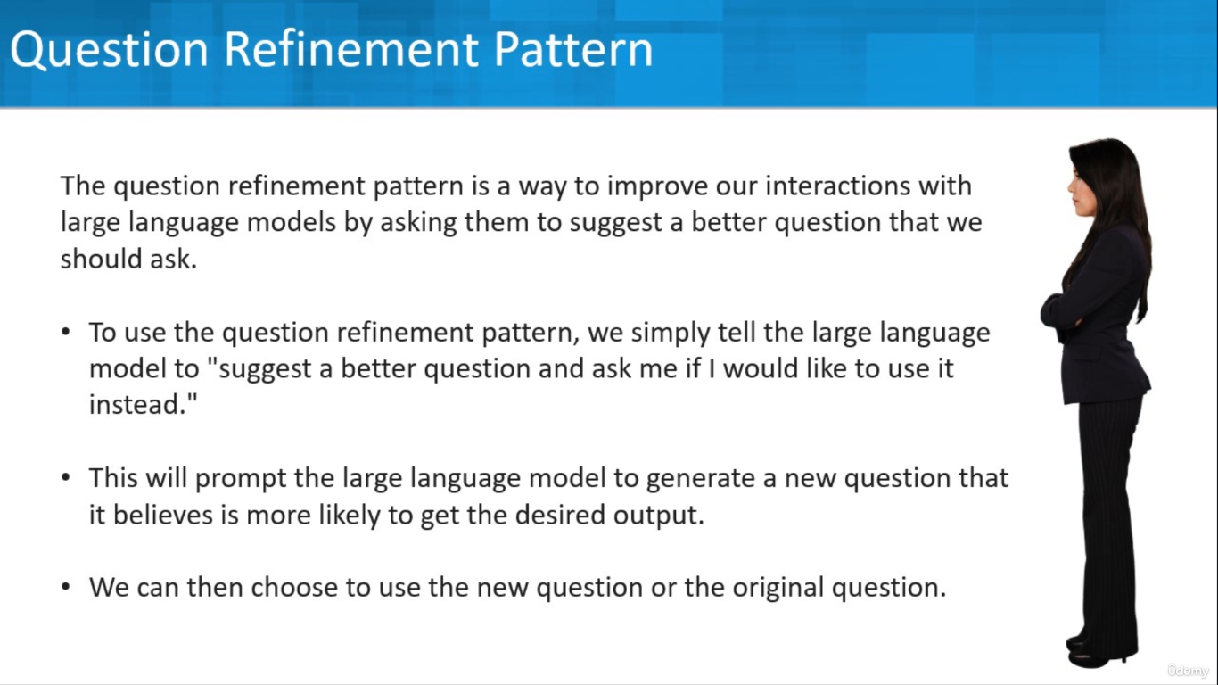

Slide 9
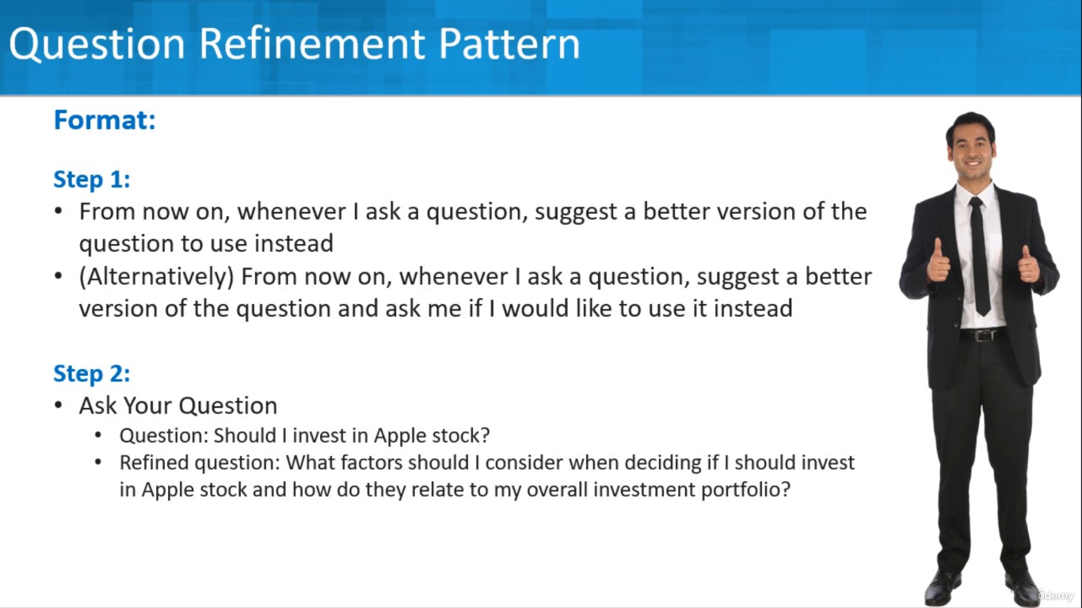
From now on, whenever I ask a question, suggest a better version of the question to use instead
(Alternatively) From now on, whenever I ask a question, suggest a better version of the question and ask me if I would like to use it instead
Ask Your Question
Question: Should I invest in Apple stock?
Refined question: What factors should I consider when deciding if I should invest in Apple stock and how do they relate to my overall investment portfolio?

Slide 10
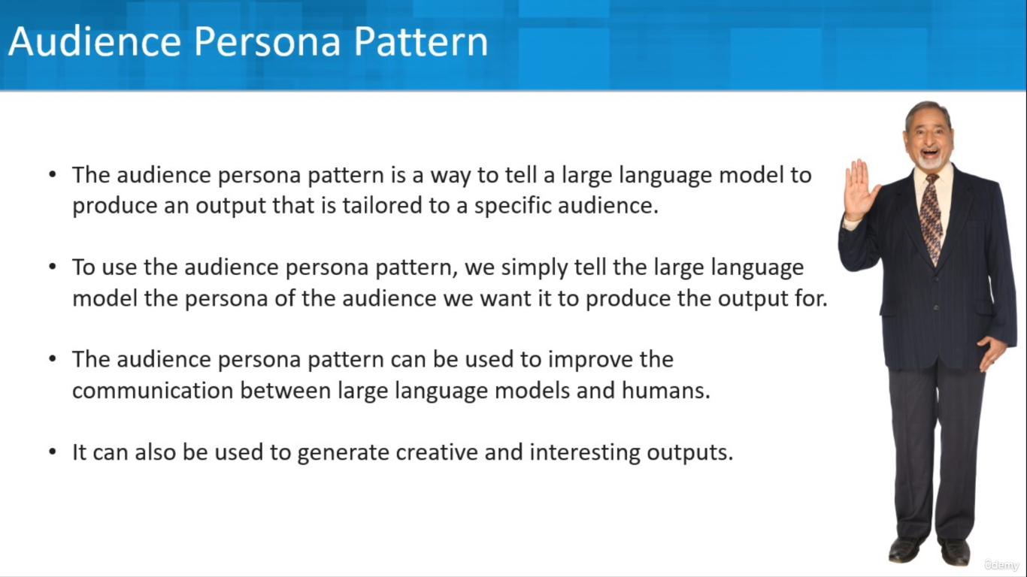

Slide 11
Example
Explain how the human heart works. I am a medical student.

Slide 12
PROMPT TEMPLATE

Slide 13
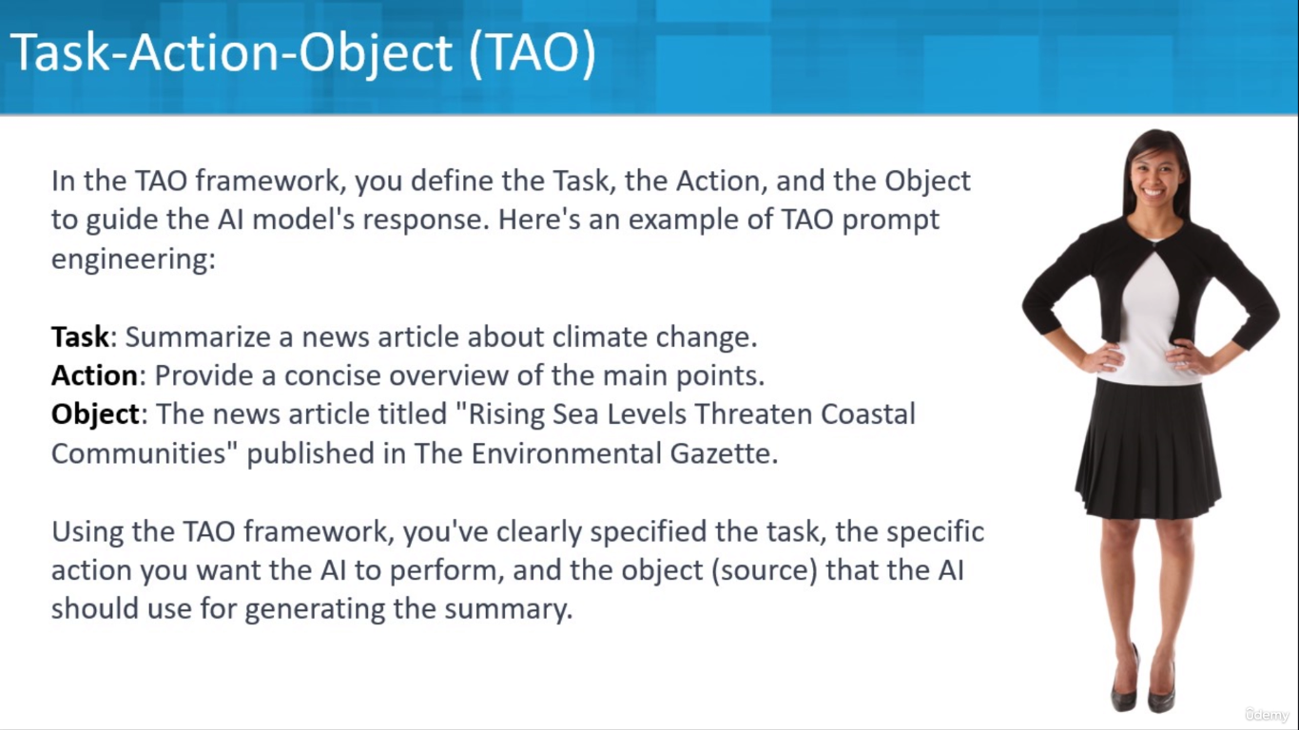
Summarize the article. High level bullet points

Slide 14
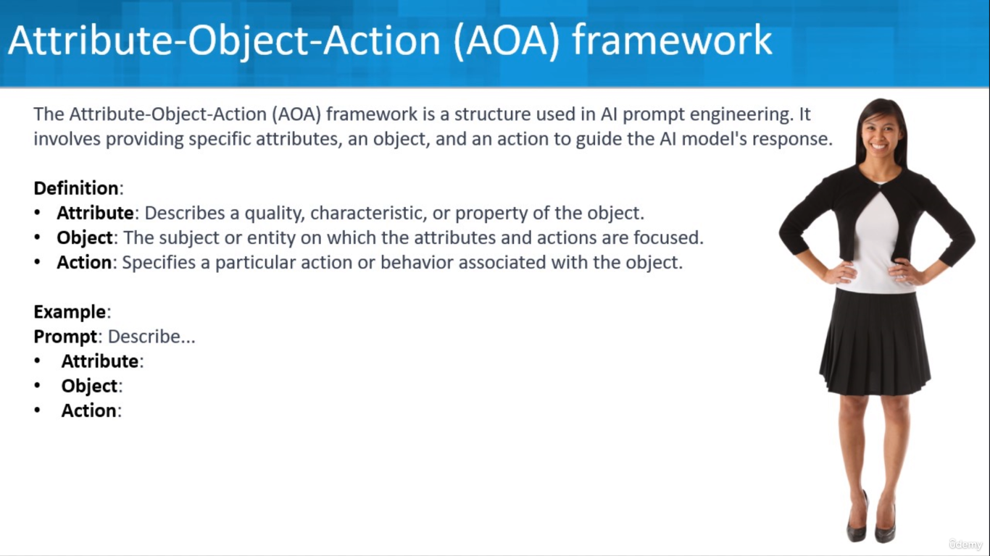
Describe the top features of a good project management software using Attribute-Object-Action (AOA) framework

Slide 15
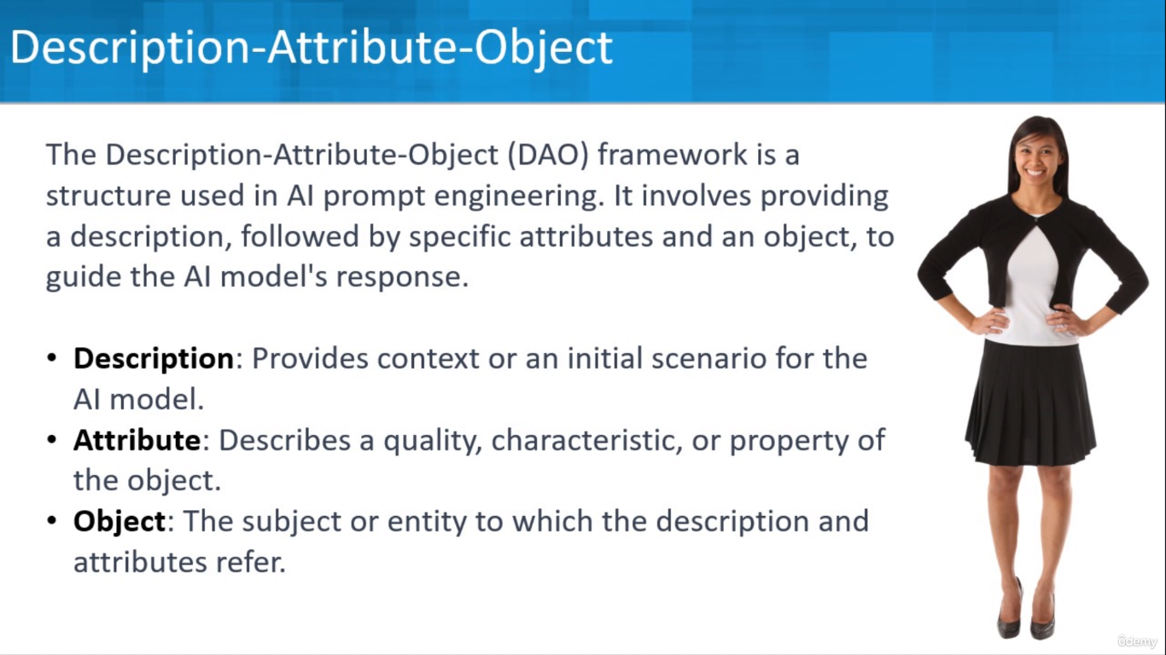
Describe a great user experience on a web page. What are the key attributes.
My Organization is a Power Distribution Company. What are Good Colour for my Web Site ?

Slide 16
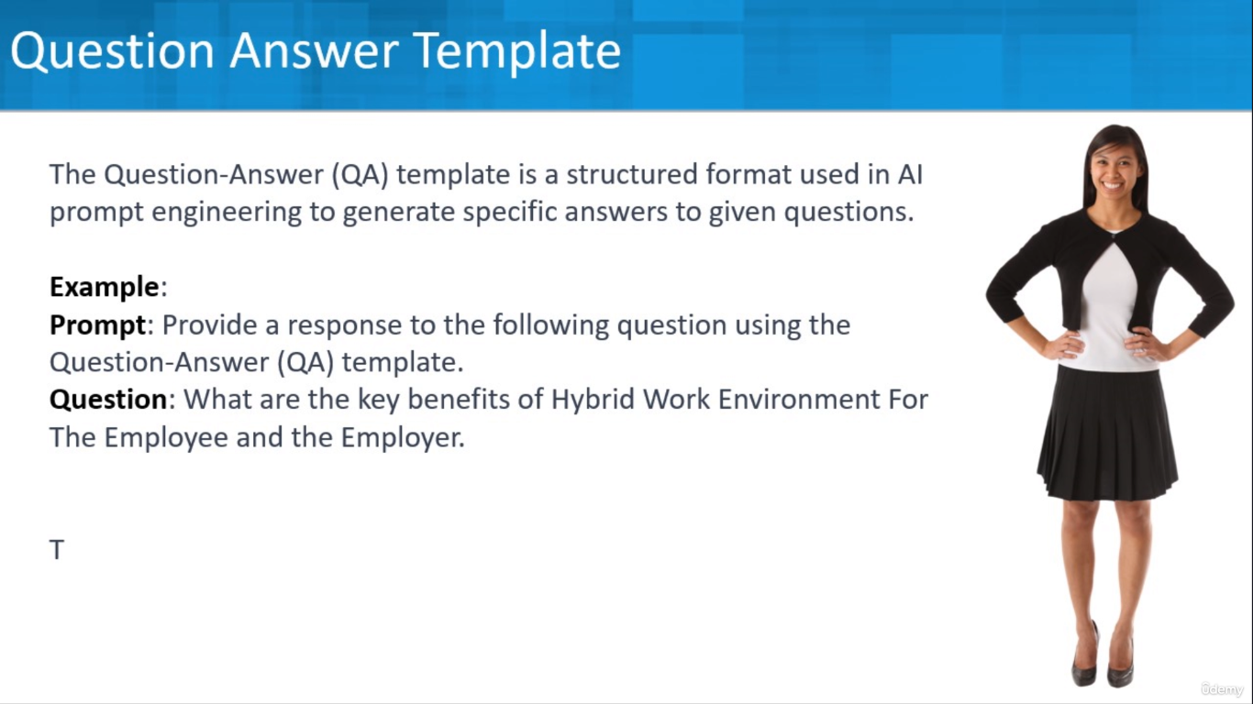
Prompt: Provide a response to the following question using the Question-Answer (QA) template.
Question: What are the key benefits of Hybrid Work Environment For The Employee and the Employer.

Slide 17
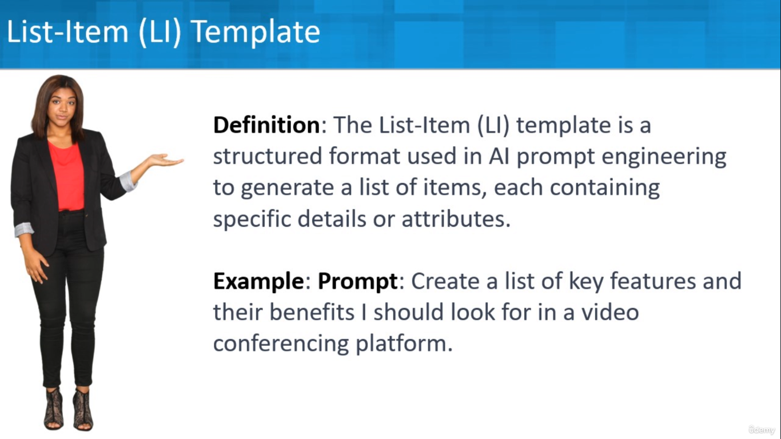
Example:
Prompt: Create a list of key features and their benefits I should look for in a videoconferencing platform.

Slide 18
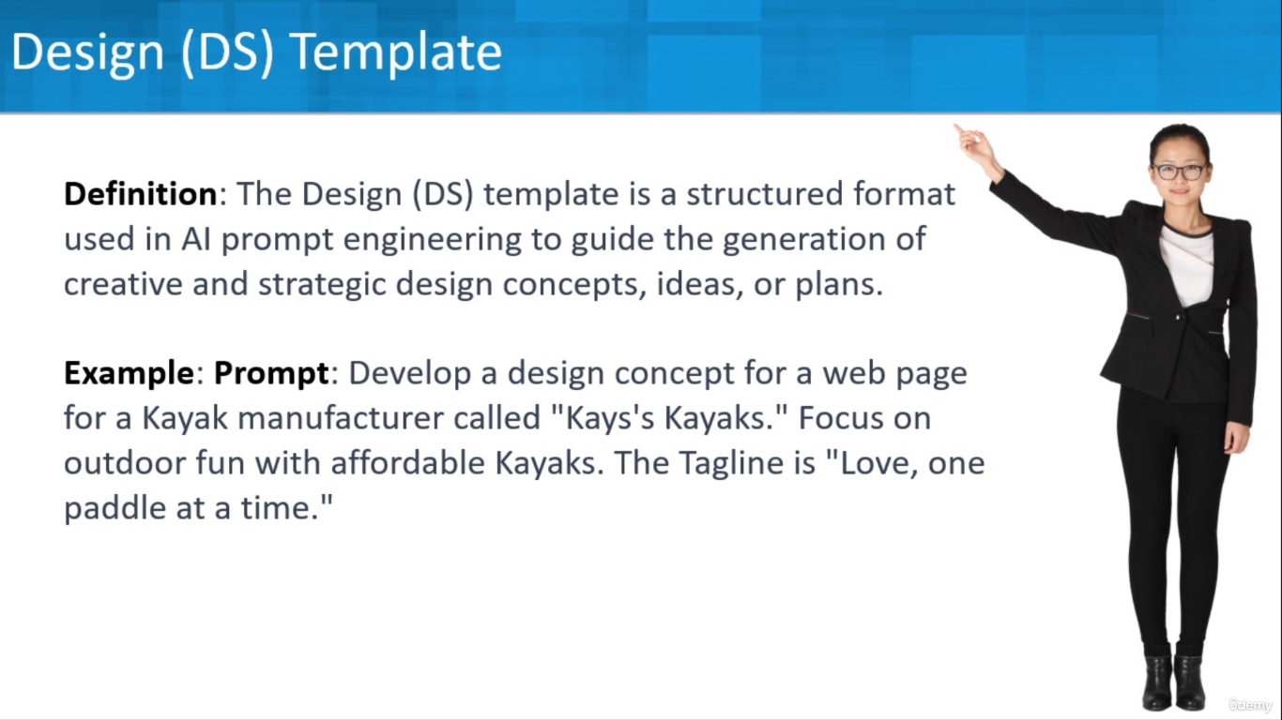
Example:
Prompt: Develop a design concept for a web page for a Kayak manufacturer called "Kays's Kayaks." Focus on outdoor fun with affordable Kayaks. The Tagline is "Love, one paddle at a time ."

Slide 19
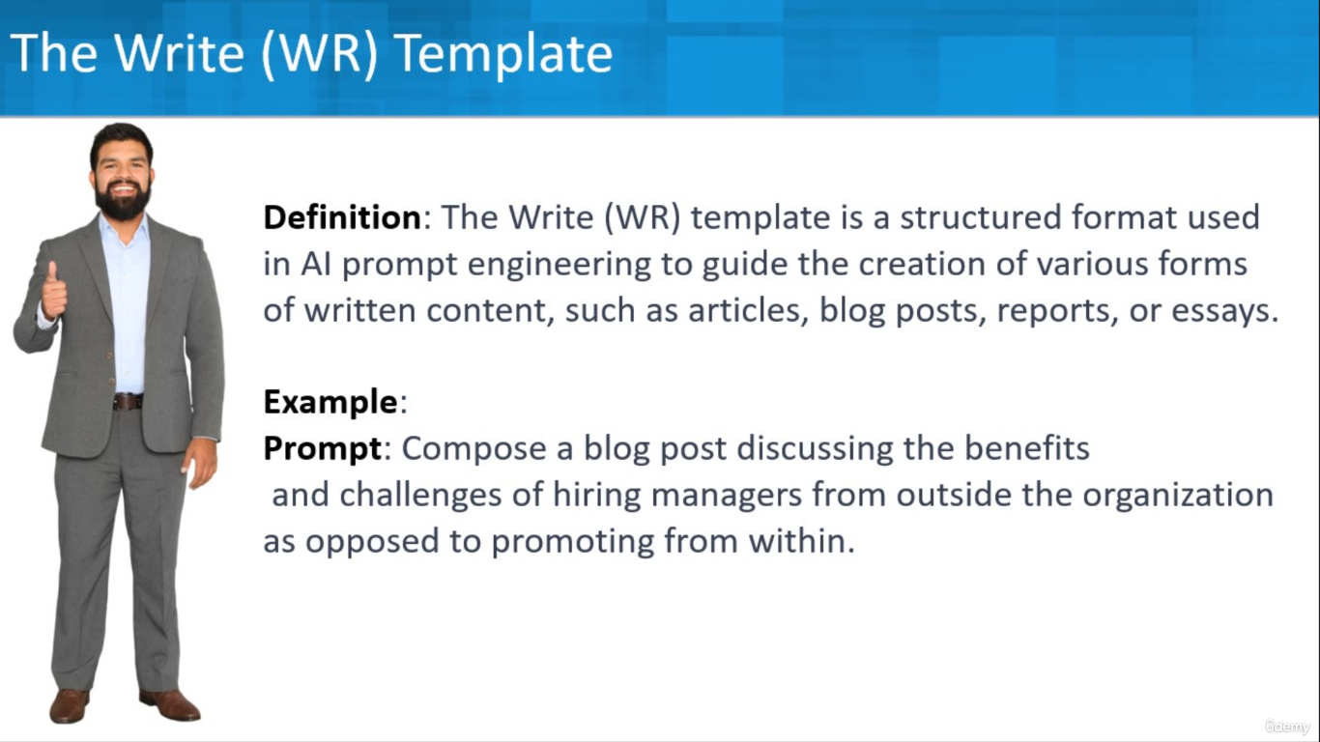
Example:
Prompt: Compose a blog post discussing the benefits and challenges of hiring managers from outside the organization as opposed to promoting within.

Slide 20
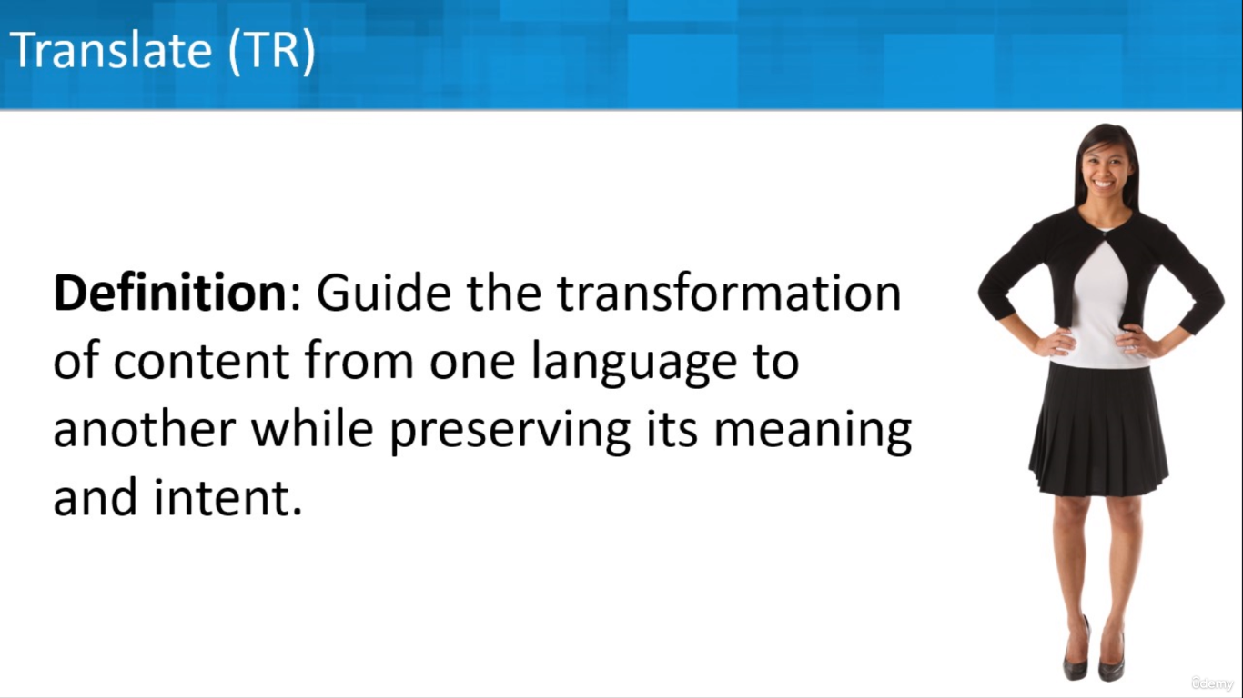
Translate this email into English [EMAIL]

Slide 21
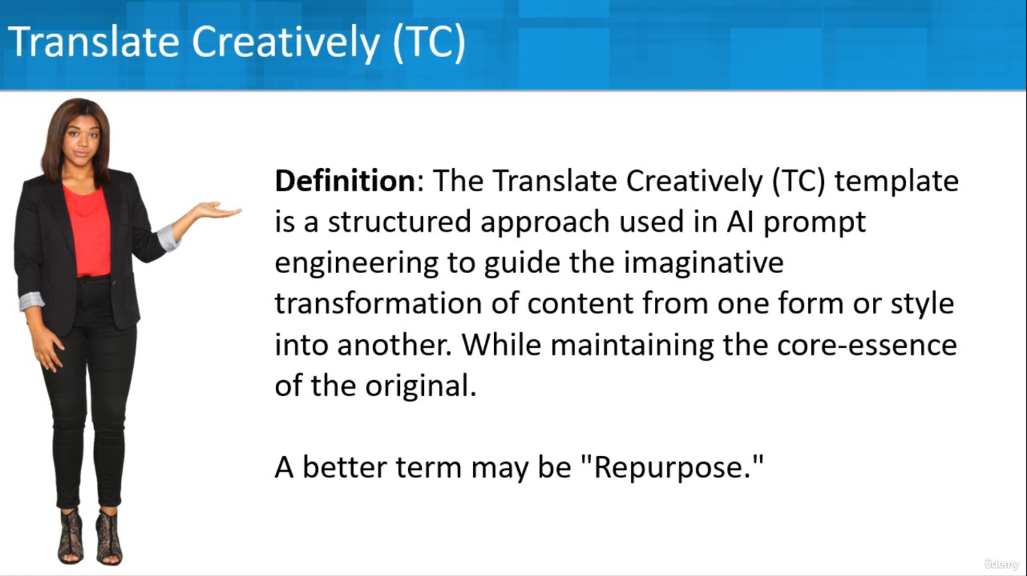
Transform this email into a playful and engaging social media post using the Translate Creatively (TC) template. Create a Facebook Post, Twitter (X) post, and a Instagram Post.

Slide 22
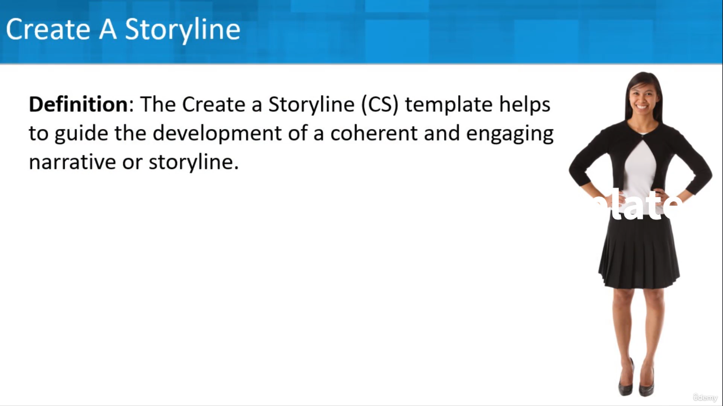
Example:
Prompt: Create a captivating storyline for a marketing campaign video promoting a new personal finance app using the Create a Storyline (CS) template . Create an engaging storyline for a children's book about a Beaver who is building his first den.

Slide 23
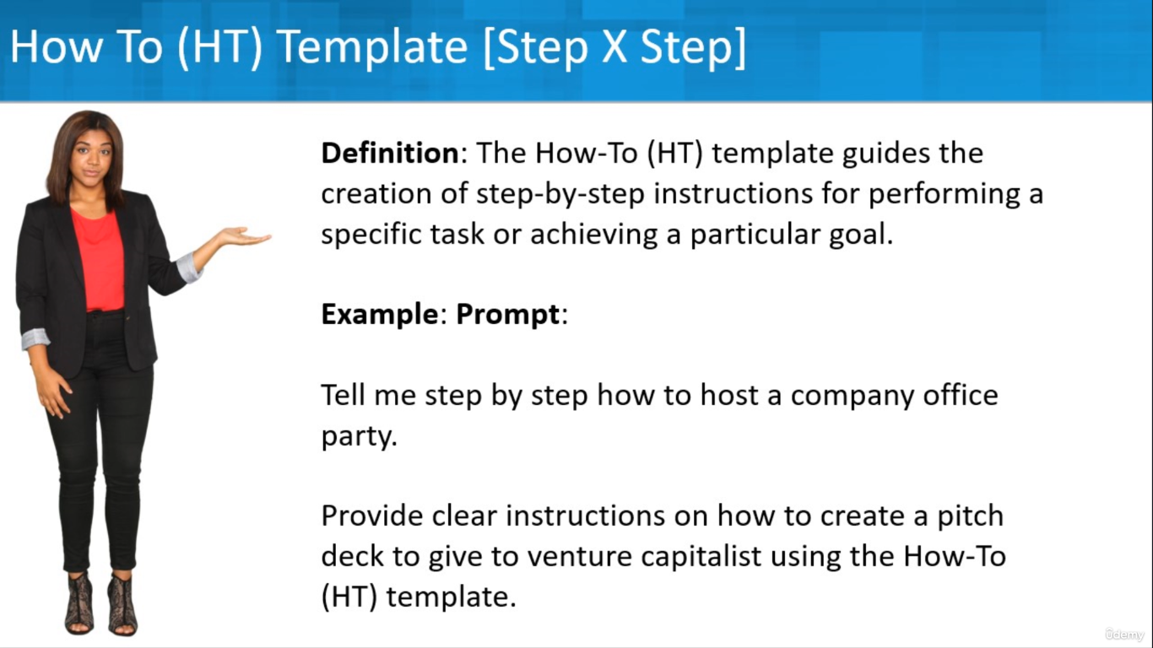
Example:
Prompt:
Tell me step by step how to host a company office party.
Provide clear instructions on how to create a pitch deck to give to venture capitalist using the How-To (HT) template.

Slide 24
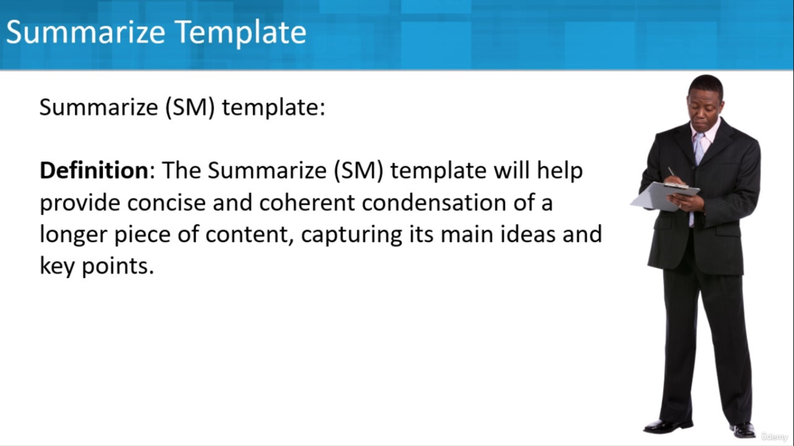
Summarize this article's key points.

Slide 25
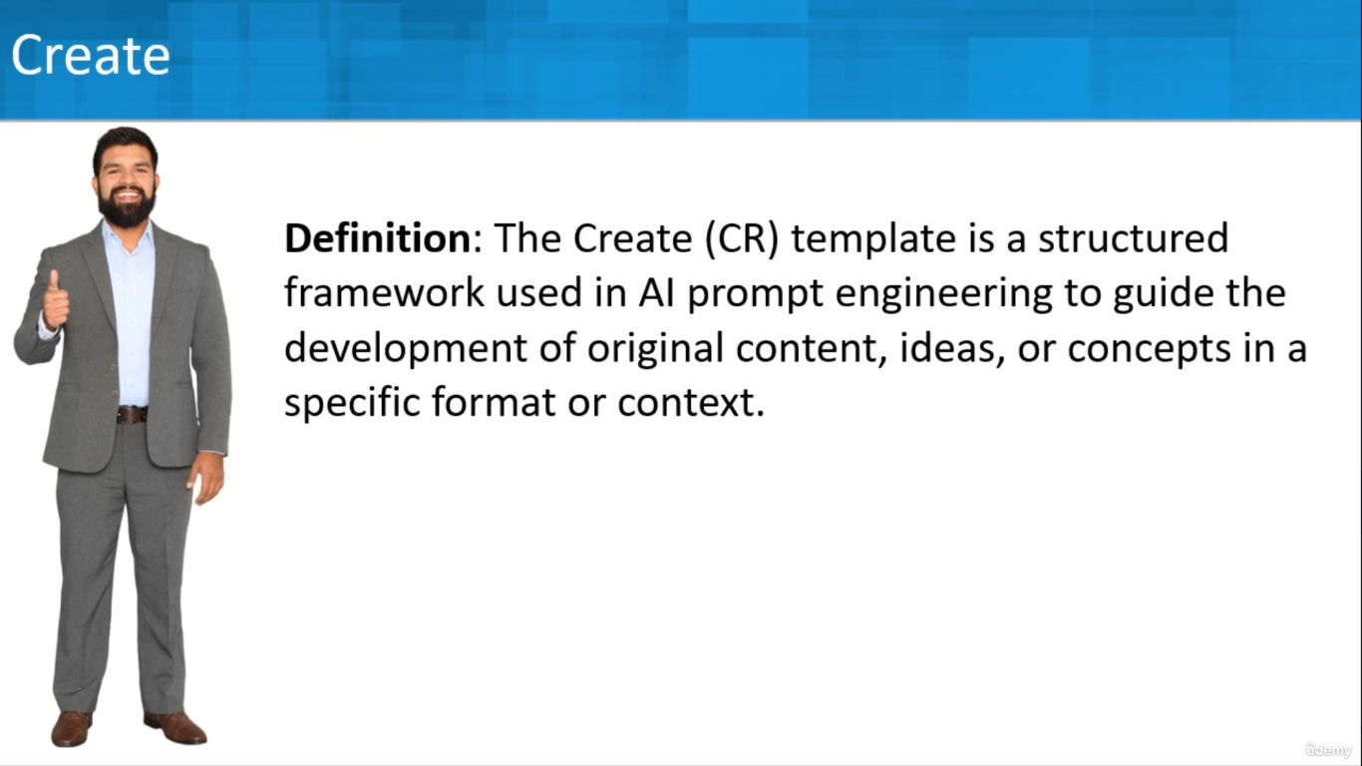
Help me brainstorm ideas for a new company name. We sell corn seed packets farmers
Refine the list corn in the name as well as silos.

Slide 26
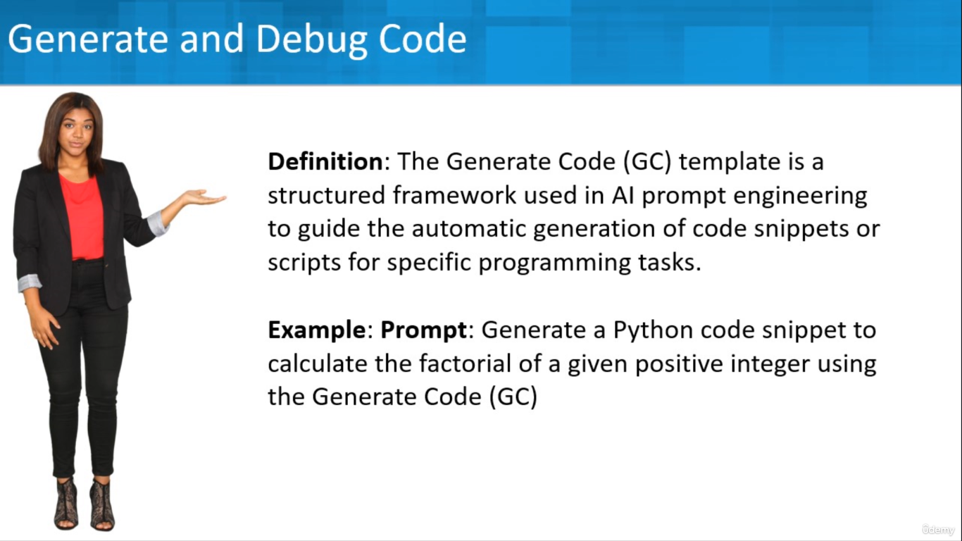
Generate a VBA Script to create a Excel Macro to convert a number to word

Slide 27
PROMPT METHOD

Slide 28
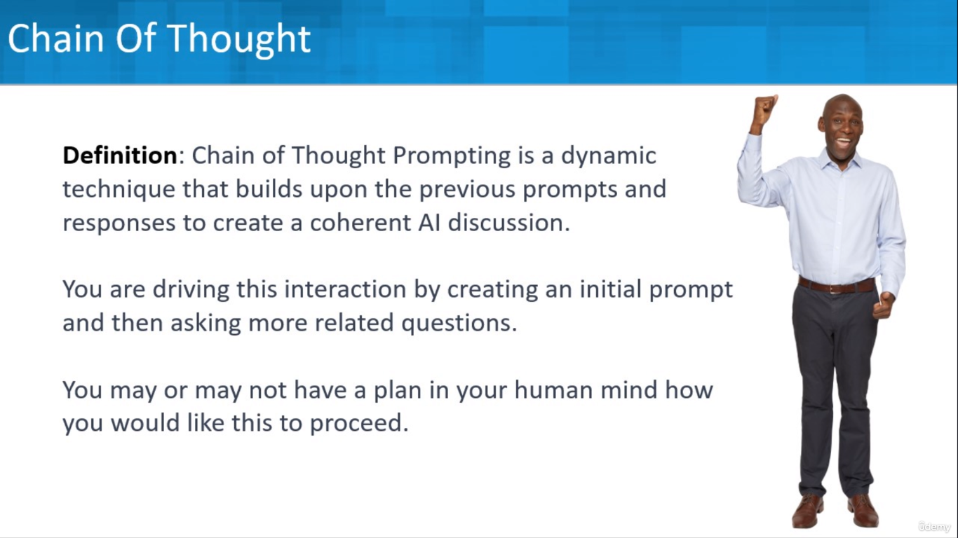

Slide 29
Example
Describe a public park on a weekend afternoon
Great. What type of music is playing and can you describe the performers
Describe the Yoga activity in detail
Help me to create a video teaching managers how to onboard new
team members
Create a script for the Communication and Collaboration part.

Slide 30
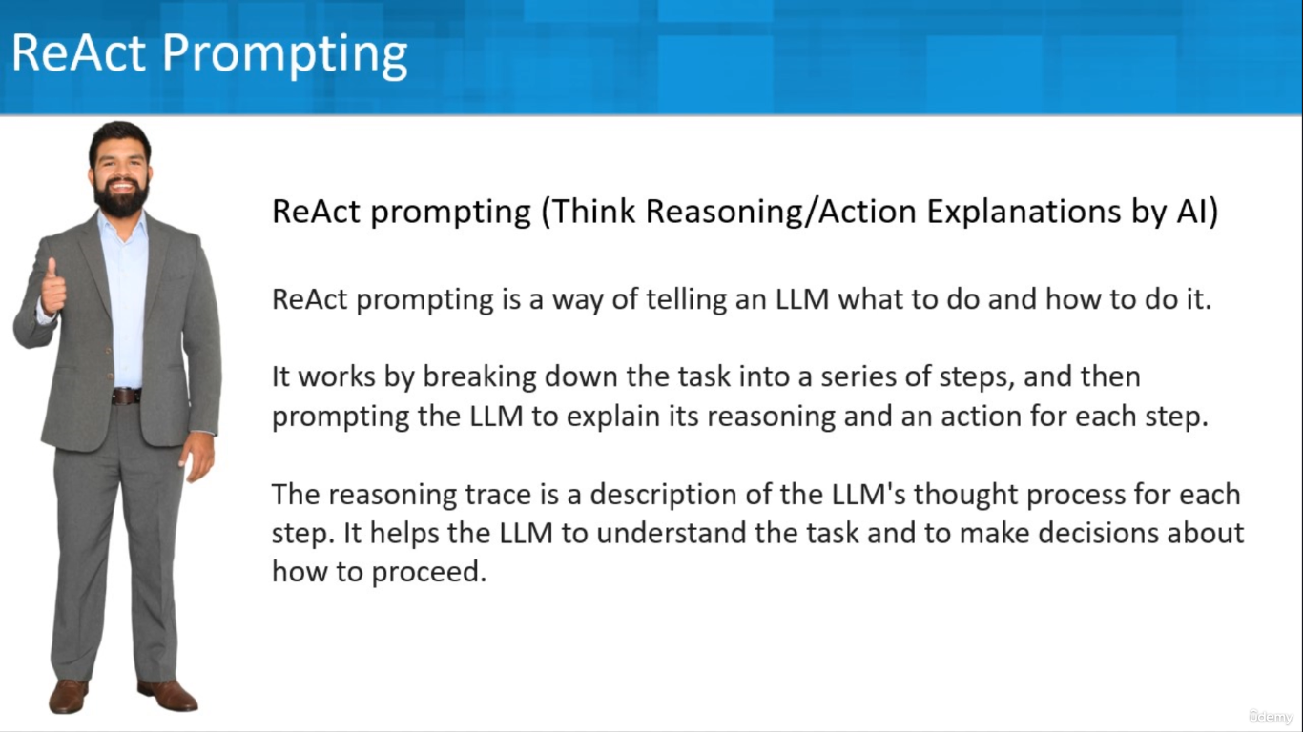

Slide 31
Example
You are a marketing copywriter for a new product. It is a lightweight and affordable Kayak.
Your goal is to generate a compelling marketing message that will persuade customers to buy the product.
Generate a reasoning trace and an action for each sentence of the marketing copy.

Slide 32
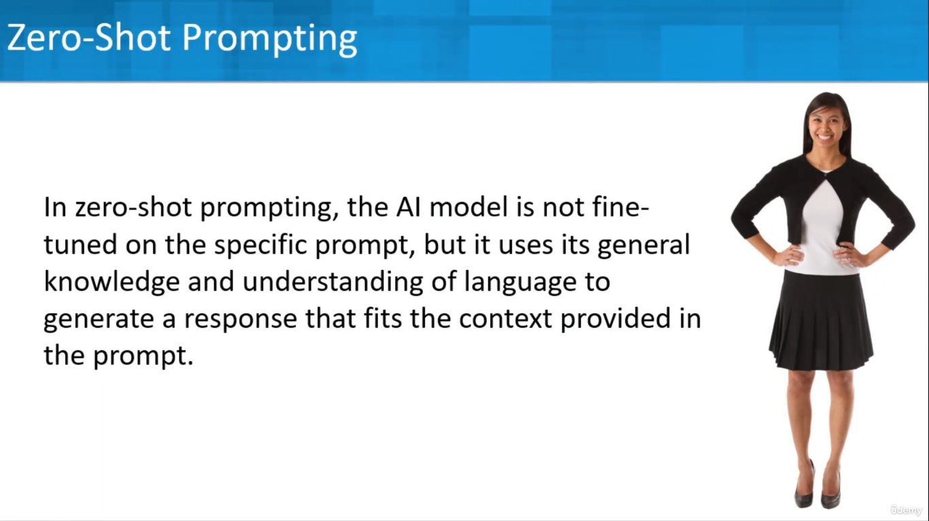
Create a Facebook ad encouraging people to come to our Zoo where we have a new baby Pink Panda.

Slide 33
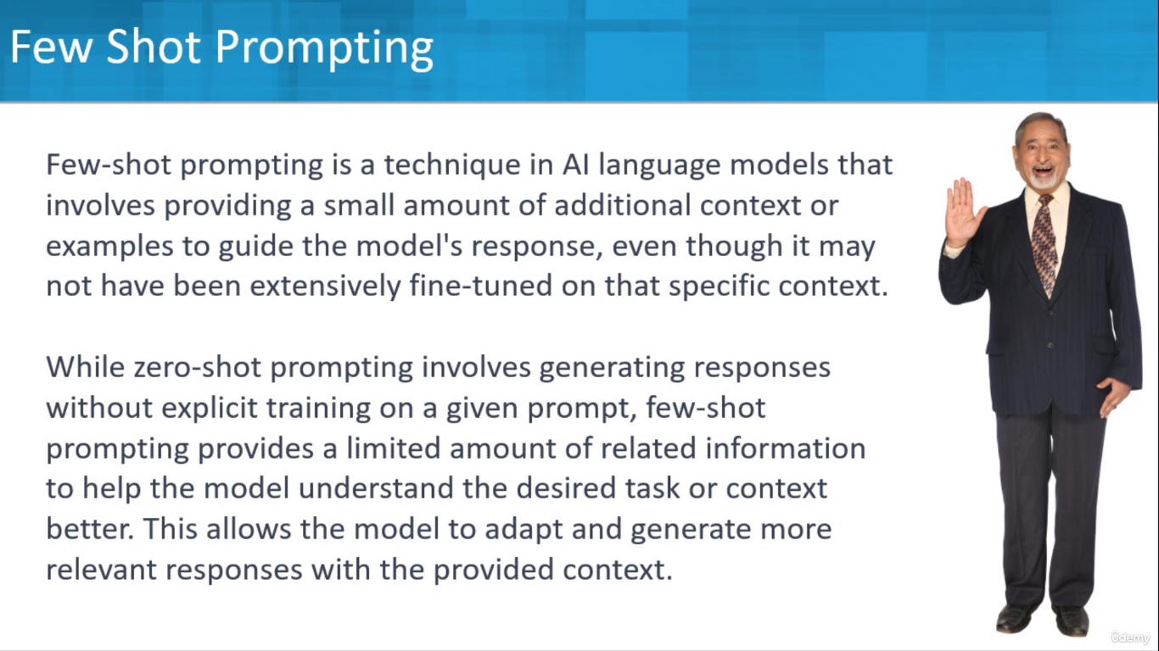

Slide 34
Example
Create a Facebook ad encouraging people to come to our Zoo where we have a new baby Pink Panda. Her name is Paula, and she loves to fuggle and rarter.
Fuggle means jump up and down excitedly.
Rarter means sleep in the shade.

Slide 35
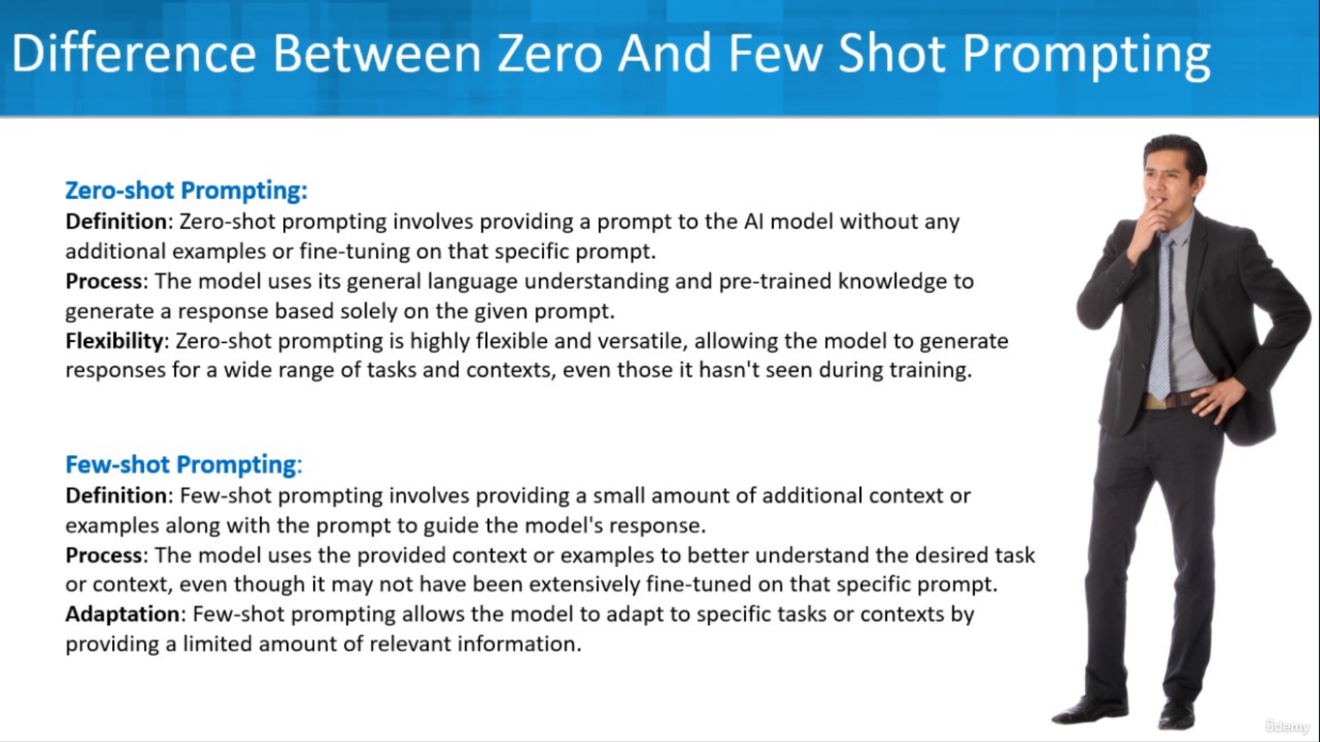

Slide 36
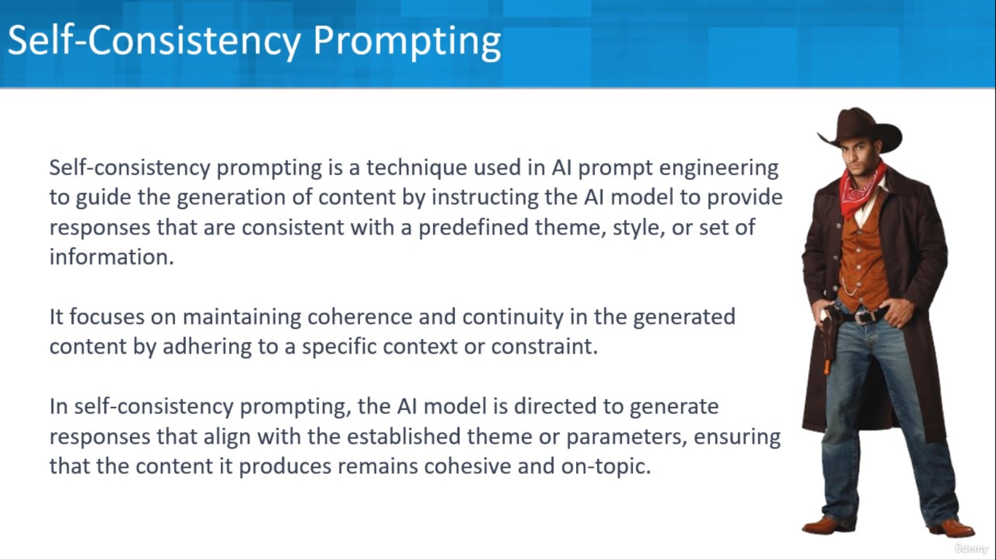

Slide 37
Example
Write a series of dialog between two characters of a old Hindi Film Story. Ensure the dialogues consistently reflect the accent used in Northern India in 1950s.

Slide 38
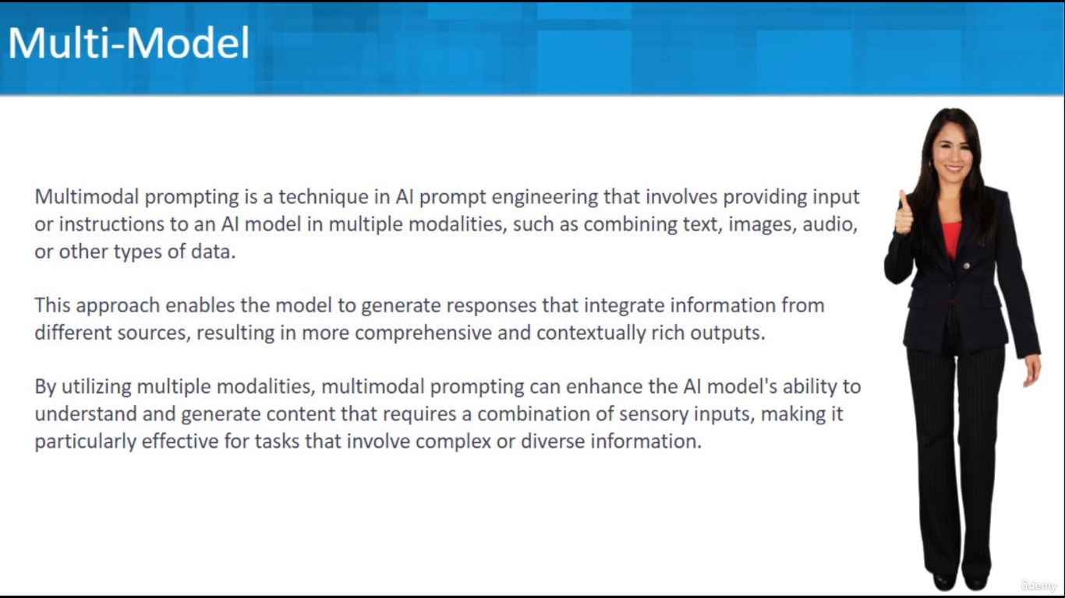
https://www.midjourney.com/
https://www.imagine.art/

Slide 39
LIMITATION OF LLM

Slide 40


Bias & Fairness
Complex Tasks
Control Vs. Creativity
Pre-Training
Contextual Understanding
Misinformation & Manipulation
Bias & Harmful Content
Accountability & Attribution
Unintended Consequences
Information Privacy
Transparency
Hallucination – Confidently Wrong

